Slide 1
Non-uniform motion

Slide 2
Non-uniform motion
If the object covers unequal distances in equal interval of times
The object’s speed/velocity changes

Slide 3
Instantaneous speed/velocity
www.youtube.com/watch?v=pfTTHx9kCHk
Instantaneous speed is a speed of an object at a particular moment in time
It is the average speed/velocity of the object in a really small interval of time

Slide 4
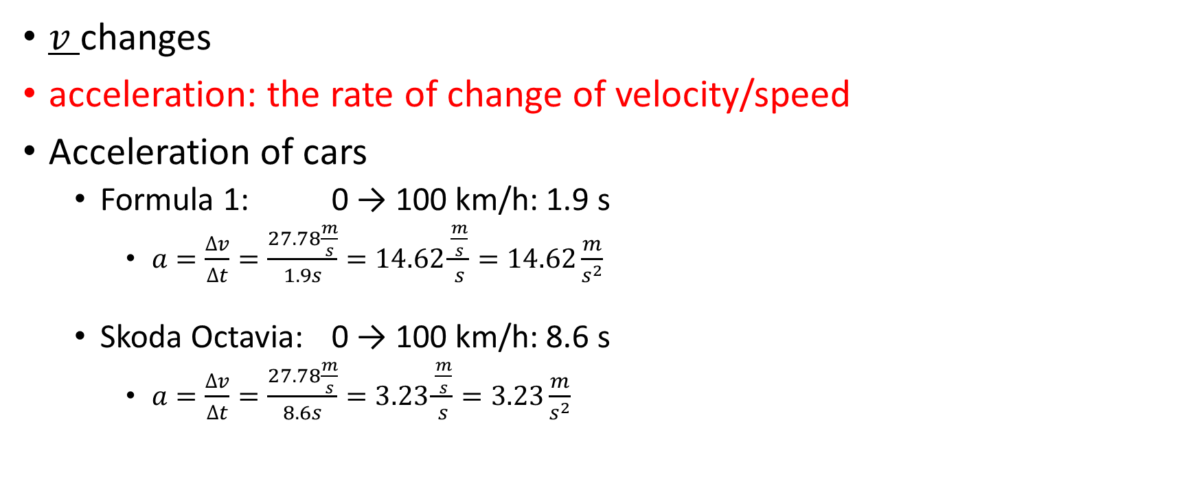
Non-uniform motion
$v$ changes
acceleration: the rate of change of velocity/speed
Acceleration of cars
Formula 1: 0 → 100 km/h: 1.9 s
$a=\frac{∆v}{∆t}=\frac{27.78\frac{m}{s}}{1.9s}=14.62\frac{\frac{m}{s}}{s}=14.62\frac{m}{s^{2}}$
Skoda Octavia: 0 → 100 km/h: 8.6 s
$a=\frac{∆v}{∆t}=\frac{27.78\frac{m}{s}}{8.6s}=3.23\frac{\frac{m}{s}}{s}=3.23\frac{m}{s^{2}}$

Slide 5
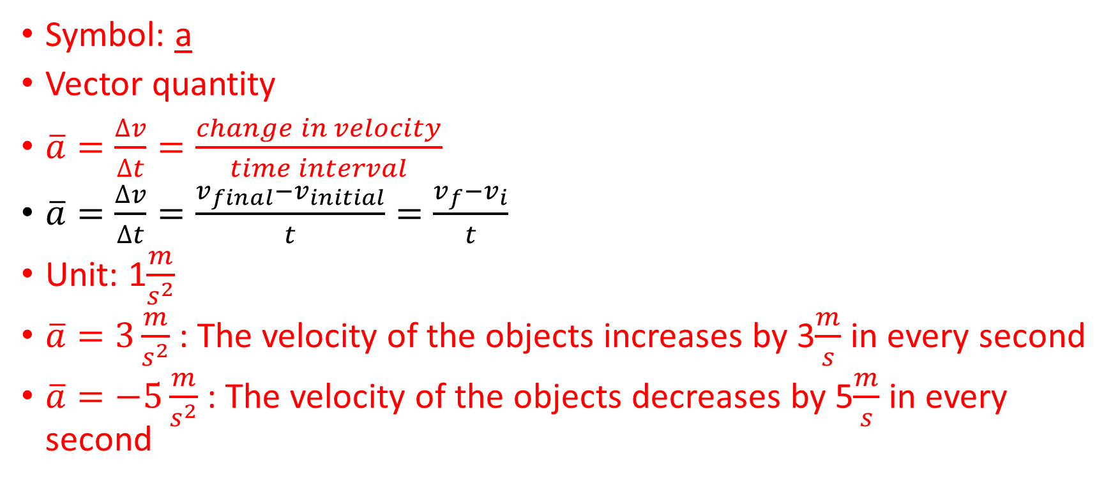
Acceleration
Symbol: a
Vector quantity
$\overline{a}=\frac{∆v}{∆t}=\frac{change in velocity}{time interval}$
$\overline{a}=\frac{∆v}{∆t}=\frac{v_{final}−v_{initial}}{t}=\frac{v_{f}−v_{i}}{t}$
Unit: 1$\frac{m}{s^{2}}$
$\overline{a}=3\frac{m}{s^{2}}$: The velocity of the objects increases by 3$\frac{m}{s}$ in every second
$\overline{a}=−5\frac{m}{s^{2}}$ : The velocity of the objects decreases by 5$\frac{m}{s}$ in every second

Slide 6
Uniformly accelerated motion along a straight line
a is constant

Slide 7
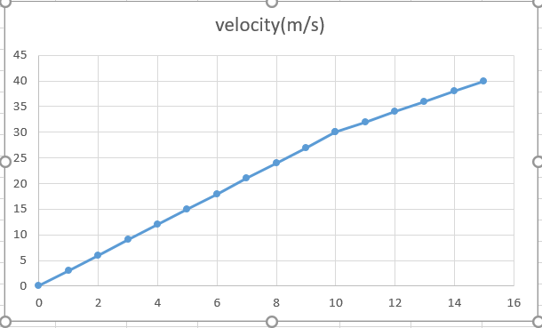
Graphs
Acceleration-time graph
Velocity-time graph

Slide 8
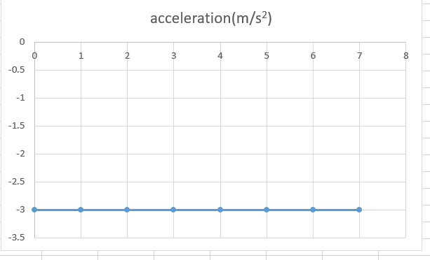
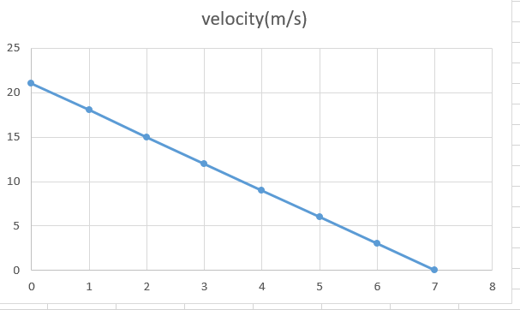
Acceleration-time graph
Velocity-time graph

Slide 9
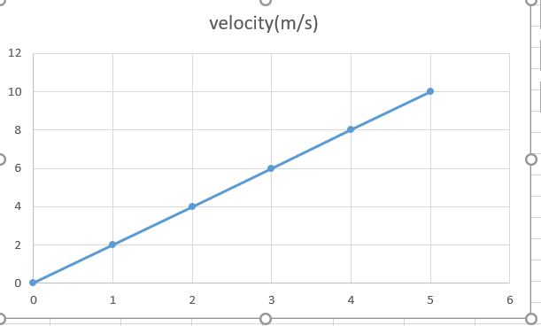
Graphs
Velocity-time graph
The slope of the velocity-time graph is equal to the acceleration of the object
The area under the graph is equal to the distance covered by the object

Slide 10

Calculate the distance from the velocity-time graph!
The area under the graph is equal to the distance covered by the object
A=$\frac{1}{2}ab=\frac{1}{2}5∙10=25 m$

Slide 11
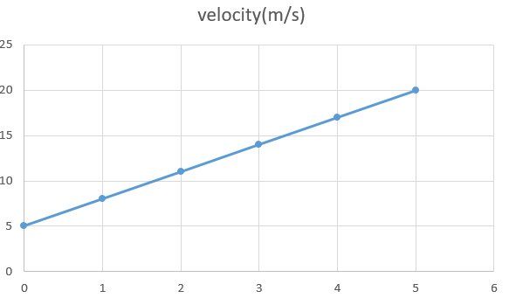
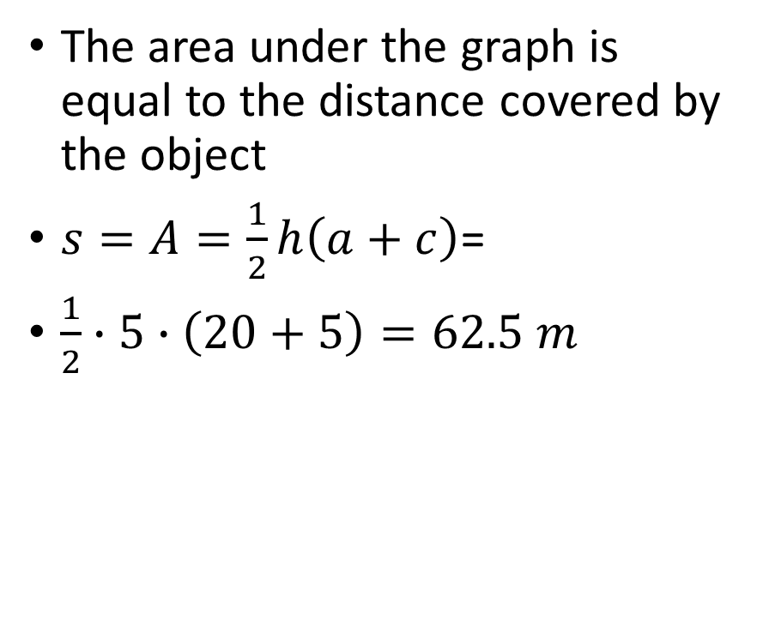
Calculate the distance from the velocity-time graph!
Velocity-time graph
The area under the graph is equal to the distance covered by the object
$s=A=\frac{1}{2}h\left(a+c\right)$=
$\frac{1}{2}∙5∙\left(20+5\right)=62.5 m$

